Slide 1
Introduction to Accessible Web
Alex Oxrud
Engineering Manager, Web
Notes:
Hello and welcome to an introduction to the Accessible Web
My name is Alex Oxrud and I am an engineering manager for the web.
I’d like to start out by asking:
How is the web built? What technologies are used?

Slide 2
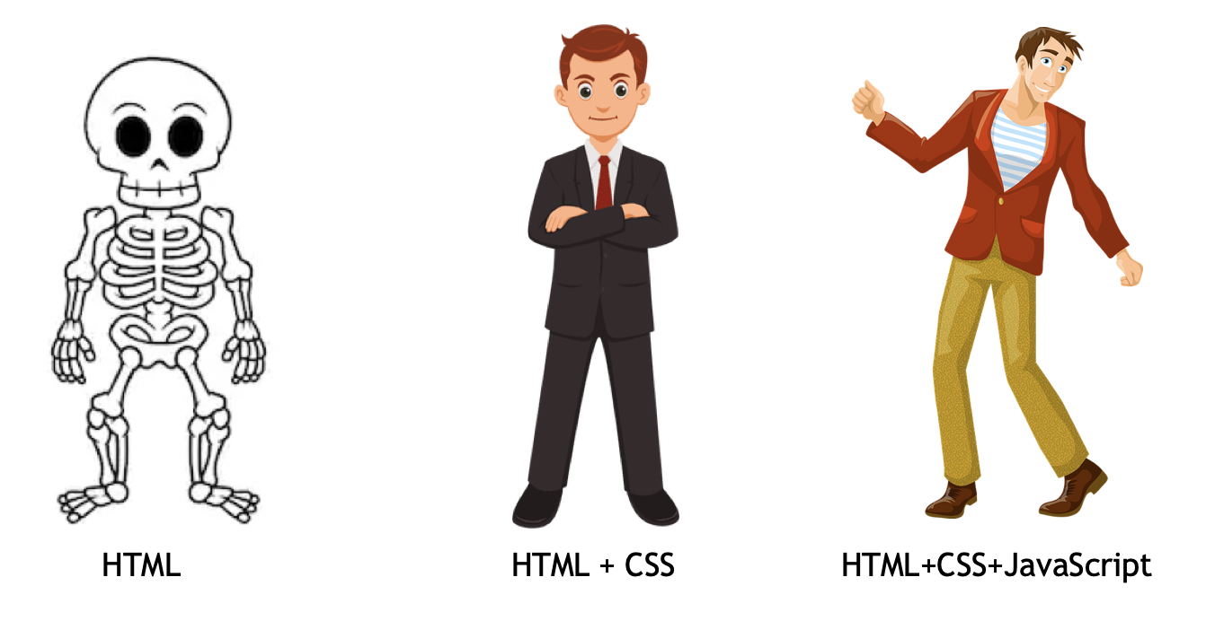
What is used to build the Web?
HTML is the skeleton
CSS describes the appearance
Javascript describes the behavior
Notes:
Before we get started with accessibility, lets recap what is used to build the web.
Every website is built using HTML and CSS, and most do contain Javascript.
You can think of HTML is the skeleton of a website and CSS as the appearance
Today we’ll be focusing on html and css.

Slide 3
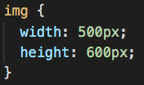
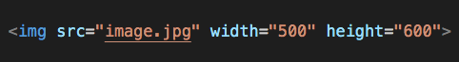
HTML / CSS
Element/Tag Attribute
Styles
Notes:
An HTML element tells the browser how to display the content.
Can anyone take a guess at what these elements do?
There are many types of html elements, in this example we have:
an image element that displays images.
an h1 element that represents a headline that says “I am a heading”
Some HTML elements can have attributes like width, height, and src.

Slide 4
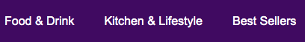
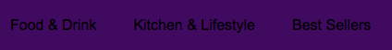
https://www.w3.org/WAI/WCAG21/Understanding/contrast-minimum.html
Notes:
If there was a website out there that had this navigation, which would you rather use? Why?

Slide 5
Color Contrast
Choosing a good color contrast helps ensure legibility.
Good Contrast:
Bad Contrast:
Ratio: 14.9:1
Ratio: 1.4:1
There are many tools that will calculate the contrast ratio for you, one of them is: https://webaim.org/resources/contrastchecker/
https://www.w3.org/WAI/WCAG21/Understanding/contrast-minimum.html
Notes:
Choosing a good color contrast helps ensure legibility.
The color contrast are expressed as ratios.
The higher the ratio, the more legible it is.
At a minimum, the contrast ratio should be 3:1
As you build interfaces, consider the how color contrast of the foreground and background affect legibility.
You can use a tool like the contrast checker by webAIM linked there that will tell you the contrast ratio between two colors and if meets the minimum guidelines.
Michael, are there any other situations where contrast would impact the experience?

Slide 6
Focus Indicator
https://www.w3.org/WAI/WCAG22/Understanding/focus-visible.html
Notes:
Why would a focus indicator be useful?
Because of aesthetics, they are often disabled. This causes a big issue for keyboard users.
The focus indicator lets you know where you are on the page and if there isn’t an indicator you’re kind of lost.

Slide 7
Focus Indicator
Keyboard navigation is usually done via the Tab key
The focus indicator helps one orient where they are in the page.
https://www.w3.org/WAI/WCAG22/Understanding/focus-visible.html
Notes:
Screen readers aren’t the only assistive technology option available to navigate sites.
One can navigate sites using the keyboard with the Tab key.
Pressing the Tab key on your keyboard will highlight interactive elements like links, buttons, and inputs.
When you highlight interactive elements, they usually receive a blue border around the element.
SEE EXAMPLE

Slide 8
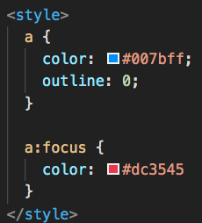
Focus Indicator
Focus indicators should always be available
Default focus styling can changed using CSS via the :focus pseudo-selector
https://www.w3.org/WAI/WCAG22/Understanding/focus-visible.html

Slide 9
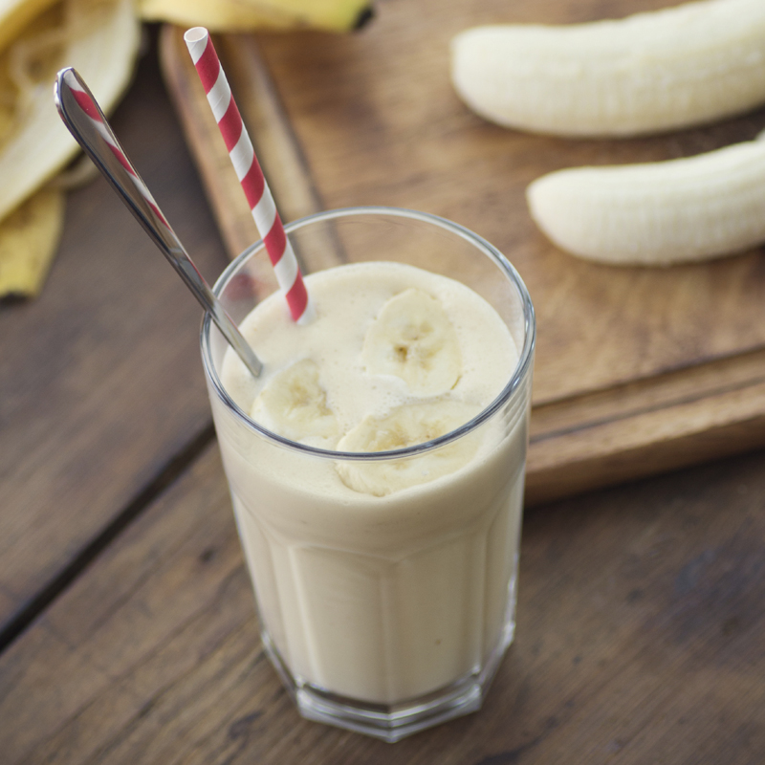
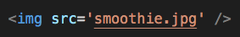
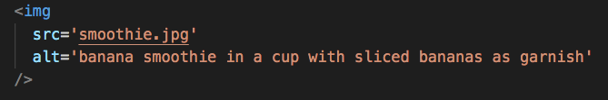
Image Alt Text
We must include image descriptions
Used by assistive technologies to describe the image.
Announced as: Unlabelled image
Announced as: banana smoothie in a cup with sliced bananas as garnish, image
https://www.w3.org/TR/UNDERSTANDING-WCAG20/text-equiv-all.html
Notes:
The web is full of images and our assistive technologies cannot yet describe what an image portrays.
Although: Artificial Intelligence is making some good progress there.
So we must ensure that our images include a description.
SEE EXAMPLES
The image element takes many attributes but the main two ones we care about are the:
Source: where the image is located
Alt: (or alternate text) that describes the image.
The alt attribute has other purposes:
If the image fails to load, it will show the alt text
If you mouse over an image with an alt text, it will often show a tooltip
Search engines index the content in the alt text and impact your site rankings

Slide 10

Menu Shop Cart
Add to Cart
Add to Cart
Add to Cart

Slide 11
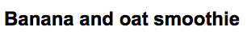
Heading
https://www.w3.org/WAI/tutorials/page-structure/headings/
Notes:
What would happen if a document didn’t have headings or different styling for headings and everything looked the same?
Why do we need headings in a document?

Slide 12
Heading
HTML headings provide valuable information of important topics and the structure of the document.
Screen readers use headlines to navigate content.
Users can jump from one headline to another to locate content faster
https://www.w3.org/WAI/tutorials/page-structure/headings/
Notes:
Headings in websites are important because they highlight the structure of the page.
Screen readers navigate sites from top to bottom and if there is a really long page, they will have to announce everything to get to the bottom of the page.
So assistive technologies came up with clever ways of navigating websites.
One of those ways is to navigate by headings in a page.
This lets the user jump to specific headlines.

Slide 13
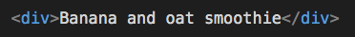
Heading
Announced as: Learning web accessibility
Announced as:
Heading level 1, Learning web accessibility
https://www.w3.org/WAI/tutorials/page-structure/headings/
Notes:
Here are two snippets of html code.
When rendered on the page, they both look like a headline but one of them is annotated as such
The main difference is in the markup:
- the left one is using a div element which doesn’t denote to assistive technologies that it is a headline.
- the example on the right is using an h1 element which represents a heading level 1
Screen readers know that heading level 1 is the most important on a page.
There are 6 headings levels available in html.
The lower the level the less importance.

Slide 14
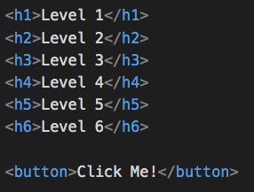
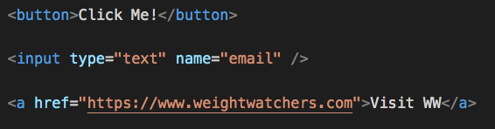
Semantic Elements
HTML elements designed with a specific purpose or intent.
Semantic elements provides accessibility for free
Links/Buttons have additional keyboard shortcuts
https://developer.mozilla.org/en-US/docs/Web/HTML/Element
Notes:
Just like h1 element, there are many other html elements that have a specific purpose.
These html elements are referred to as semantic elements.
Semantic elements provides accessibility for free
They are recognized by screen readers as having special functionality.
For example, buttons and links have keyboard shortcuts, like you can use the Enter key to activate them. Headlines can be located more easily by screen readers.

Slide 15
Semantic Elements
Announced as: See recipe
Announced as: link, See recipe
https://developer.mozilla.org/en-US/docs/Web/HTML/Element
Notes:
How does the announcement change your expectation?
The first one that says “see recipe”
It does not get announced as a link.
Screen reader users will not know that “see recipe” is a clickable link.

Slide 16
Semantic Elements
Announced as: See recipe
Announced as: link, See recipe
https://developer.mozilla.org/en-US/docs/Web/HTML/Element
Notes:
In this example, we have a link that when clicked will go to a banana pancake recipe.
These two examples can visually look identical and when clicked will go to the same place, however, they are not the same.
The example on the bottom will be announced as a link.
Users will immediately know that it can be interacted.
Because it is using an anchor link, it will have special keyboard shortcuts associated with it. Like pressing the Enter key to access the link.

Slide 17
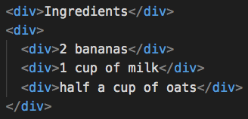
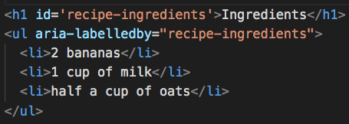
Semantic Elements
Announced as: Ingredients
2 bananas
1 cup of milk
half a cup of oats
Announced as: Heading level 1, Ingredients
list, Ingredients, 3 items 2 bananas, 1 of 3
1 cup of milk, 2 of 3
Half a cup of oats, 3 of 3
end of list
https://developer.mozilla.org/en-US/docs/Web/HTML/Element
Notes:
Another example is a list of ingredients for a banana smoothie recipe.
The example on the left just says what is declared.
The example on the right provides more context:
- it has a headline so we can quickly locate the ingredients
- the list will announce how many ingredients to expect
- as you step through each item, it will tell you where you are in the list.

Slide 18
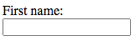
Input and Labels
https://developer.mozilla.org/en-US/docs/Web/HTML/Element/label
Notes:
Nearly every website has some sort of input where you can enter some information.
In this example, we can guess that the input is for us to enter the first name.
We are able to tell that because the first name label is visually located on top of the input box.
However, it’s not enough to display a label close to an input.
We must programmatically link the label to the input for it to be usable to screen readers.

Slide 19
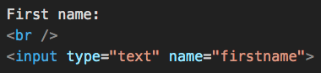
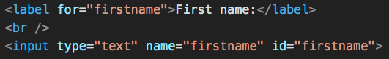
Input and Labels
All inputs need to have a label associated with it.
Screen reader will read of the label when user lands on the input.
Announced as: edit text, blank
Announced as: First name:, edit text
https://developer.mozilla.org/en-US/docs/Web/HTML/Element/label
Notes:
Every input on the a website should have a label associated with it.
Screen reader will read of the label when user lands on the input.
SEE EXAMPLES
The label musts be linked to the input using the `<label>` element with a “for” attribute that points to the input’s id attribute.

Slide 20
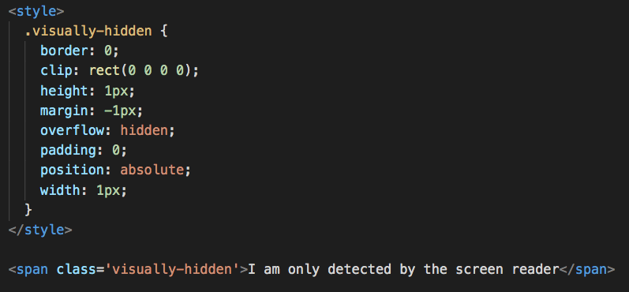
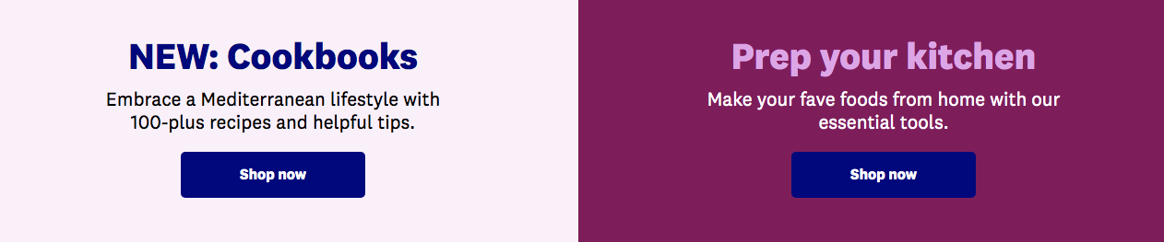
Hidden Context
Assistive technology may navigate by links on the page.
Ensure links on the page have unique labels
Notes:
Just like screen readers navigate websites by headlines, they can navigate a website by links.
In our example, we have a screenshot from the WW Shopping website and two links with with a generic label that says “shop now”
Most times, the visual design of the webpage provides context for a link.
Visually we know that each “shop now” relates to cookbooks or kitchen tools.
But someone who is only navigating by links does not have that additional context.
We should ensure that all links have unique labels.
Sometimes adding labels will make the interface a bit redundant.
One way to keep the design tidy and still provide unique labels is to use hidden text
This text is announced by screen readers but they are not visible on the page.

Slide 21
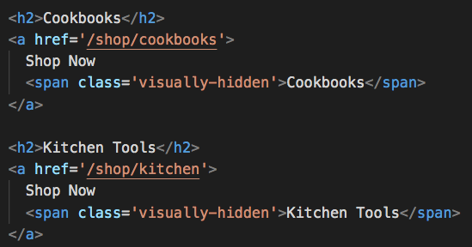
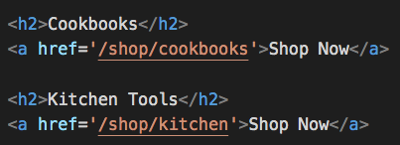
Hidden Context
Announced as:
link, Shop Now
link, Shop Now
Announced as:
link, Shop Now Cookbooks
link, Shop Now Kitchen Tools
Notes:
Explain the differences in examples.
There are other ways to include additional context

Slide 22
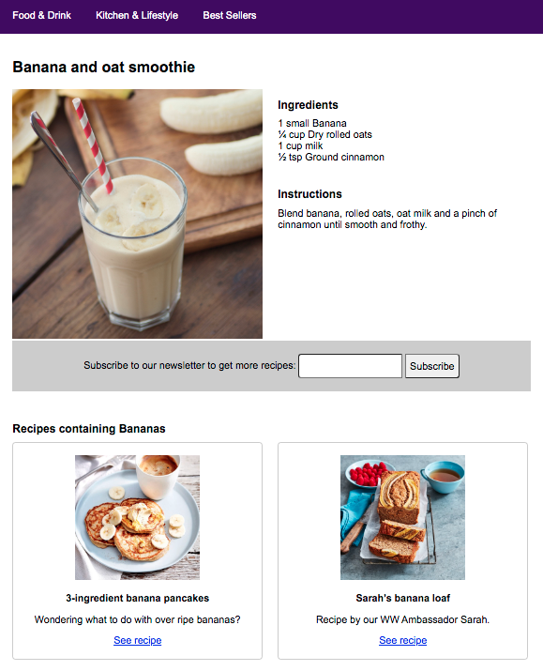
Demo Time
Built a recipe webpage using the examples we saw:
Minimal accessibility
Accessibility in mind
We’ll navigate each website with a screen reader and see the differences.
Notes:
I built two visually identical recipe webpages using the non-accessible examples and the accessible examples.
We’ll navigate each website with a screen reader and see the differences.

Slide 23
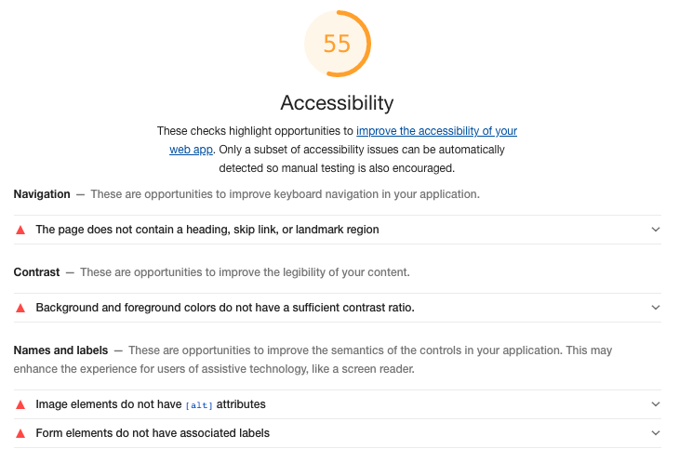
Demo - Subpar
Notes:
Explain Chrome Lighthouse
Highlights markup violations
Not necessarily usability violations.
For this demo:
Built the site without semantic elements.
DEMO TIME

Slide 24
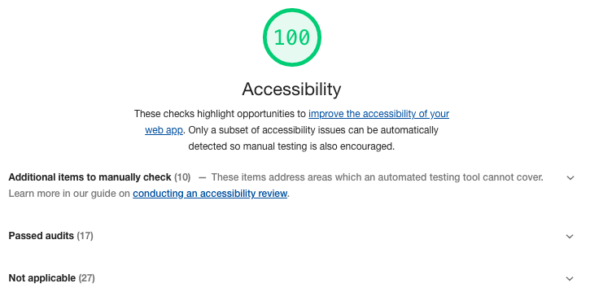
Demo - Better
Notes:
For this demo:
Fixed contrast ratio
semantic elements for headlines and links.
linked labels to inputs.

Slide 25
Questions?
https://github.com/aoxrud-ww/girls-who-code

